Slide 1
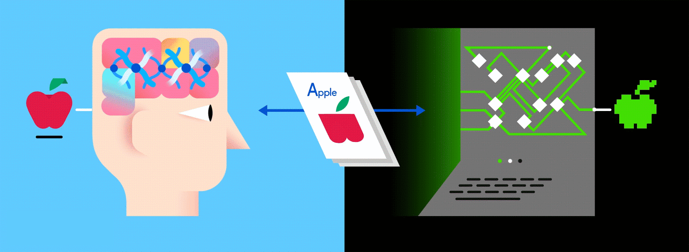
fesf
Convolution neural network for Image processing
Navin Prasad S.V

Slide 2

Data :
It can be any unprocessed fact, value, text, sound or picture that is not being interpreted and analysed.
Data is the most important part of all Data Analytics, Machine Learning, Artificial Intelligence.
Without data, we can’t train any model and all modern research and automation will go vain.
Big Enterprises are spending lots of money just to gather as much certain data as possible.
90%
of all data in existence today
was created
in the past two years.
Navin Prasad S.V

Slide 3
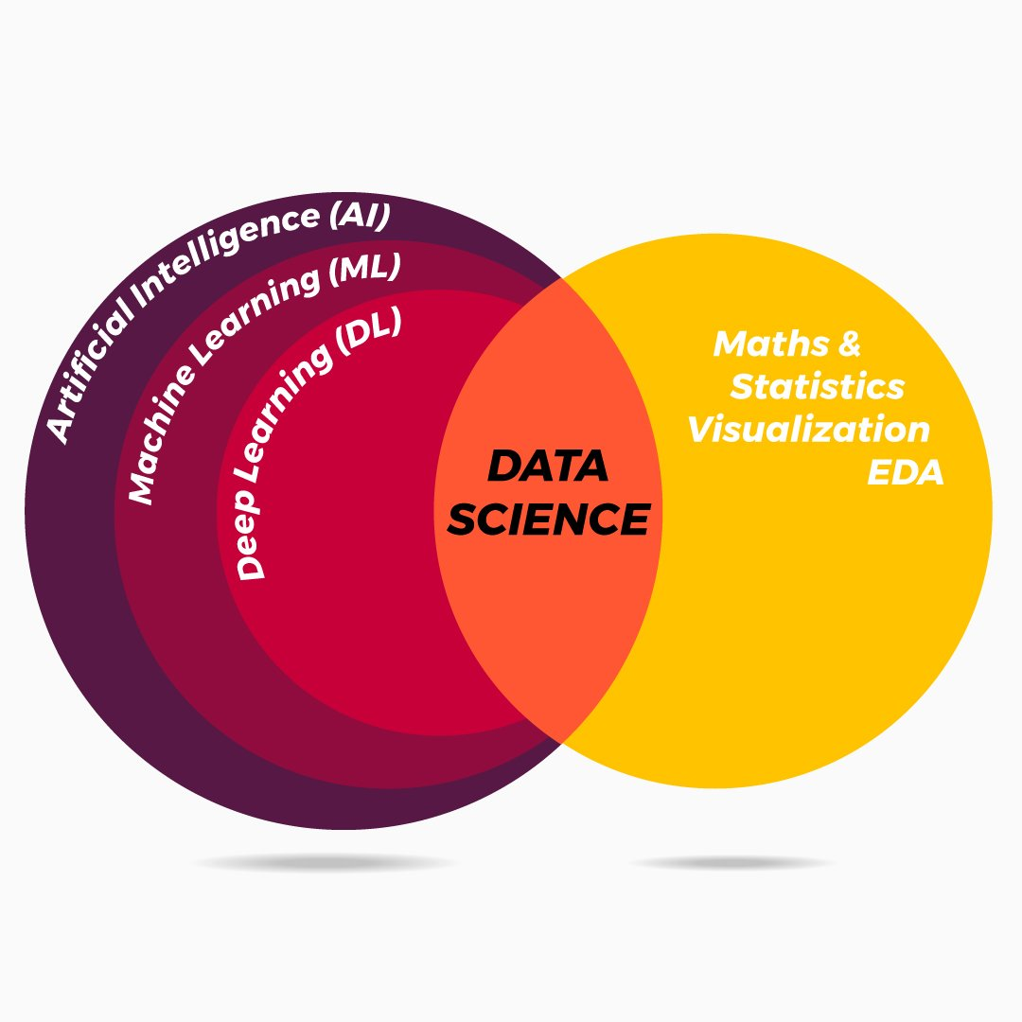
Sectors in Artificial Intelligence:
How do these sectors help us ?
They help us to process data and provide us back with valuable insights.
Processing Structure and Unstructured data for Predication and Classification tasks.
Natural language processing.
Image Processing.
Sales Predication by analysing previous years trend.
Navin Prasad S.V

Slide 4
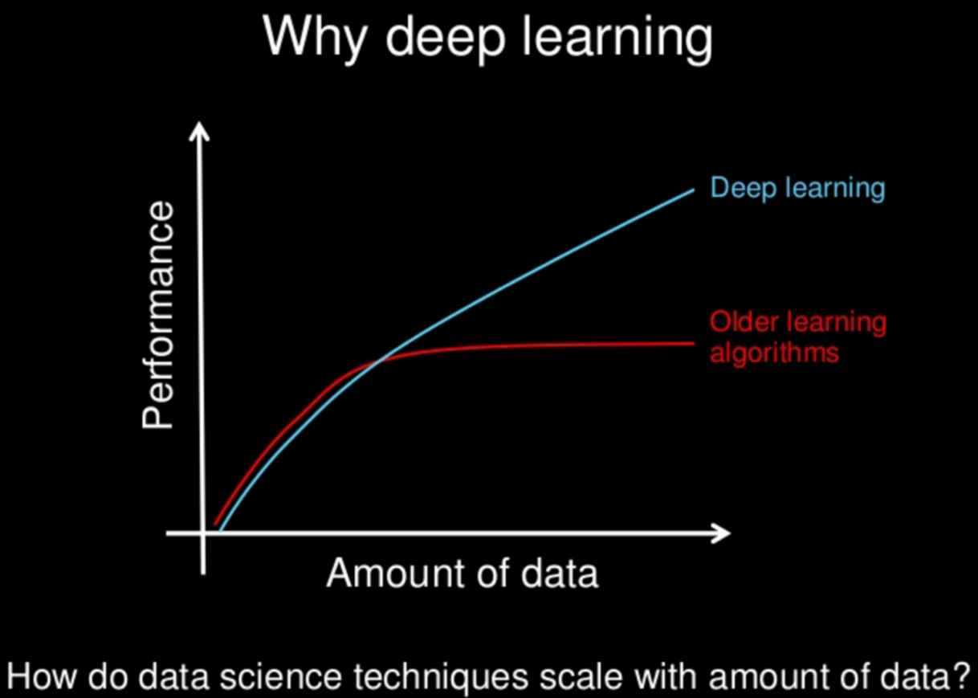
Machine Learning vs Deep learning :
The most important difference between deep learning and traditional machine learning is its performance as the scale of data increases.
When the data is small, deep learning algorithms don’t perform that well. This is because deep learning algorithms need a large amount of data to understand it perfectly. On the other hand, traditional machine learning algorithms with their handcrafted rules prevail in this scenario. Below image summarizes this fact.
Navin Prasad S.V

Slide 5

Neural Network

Slide 6
Neural Network:
Biological Neuron: Basic computational unit of the Brain. Interconnect to form a web (brain).
• Each neuron receives input signals from its dendrites
• Input signals interact multiplicatively (w0x0) with dendrites.
• Produces output signals along its axon.
• Axon branches out and connects via synapses to dendrites of other neurons
Artificial (Computational) Neuron:
• Input, Weights, Sum, Threshold
Biological Neuron
Artificial Neuron

Slide 7
Neural Network - Abstract: Neural network is a place where multiple layers of neurons are trained on a single problem statement to gain a better prediction result.
Neural Network Hyper Parameters:
The number of hidden layers.
Number of neurons inside the hidden layer.
Activation function inside neuron.

Slide 8
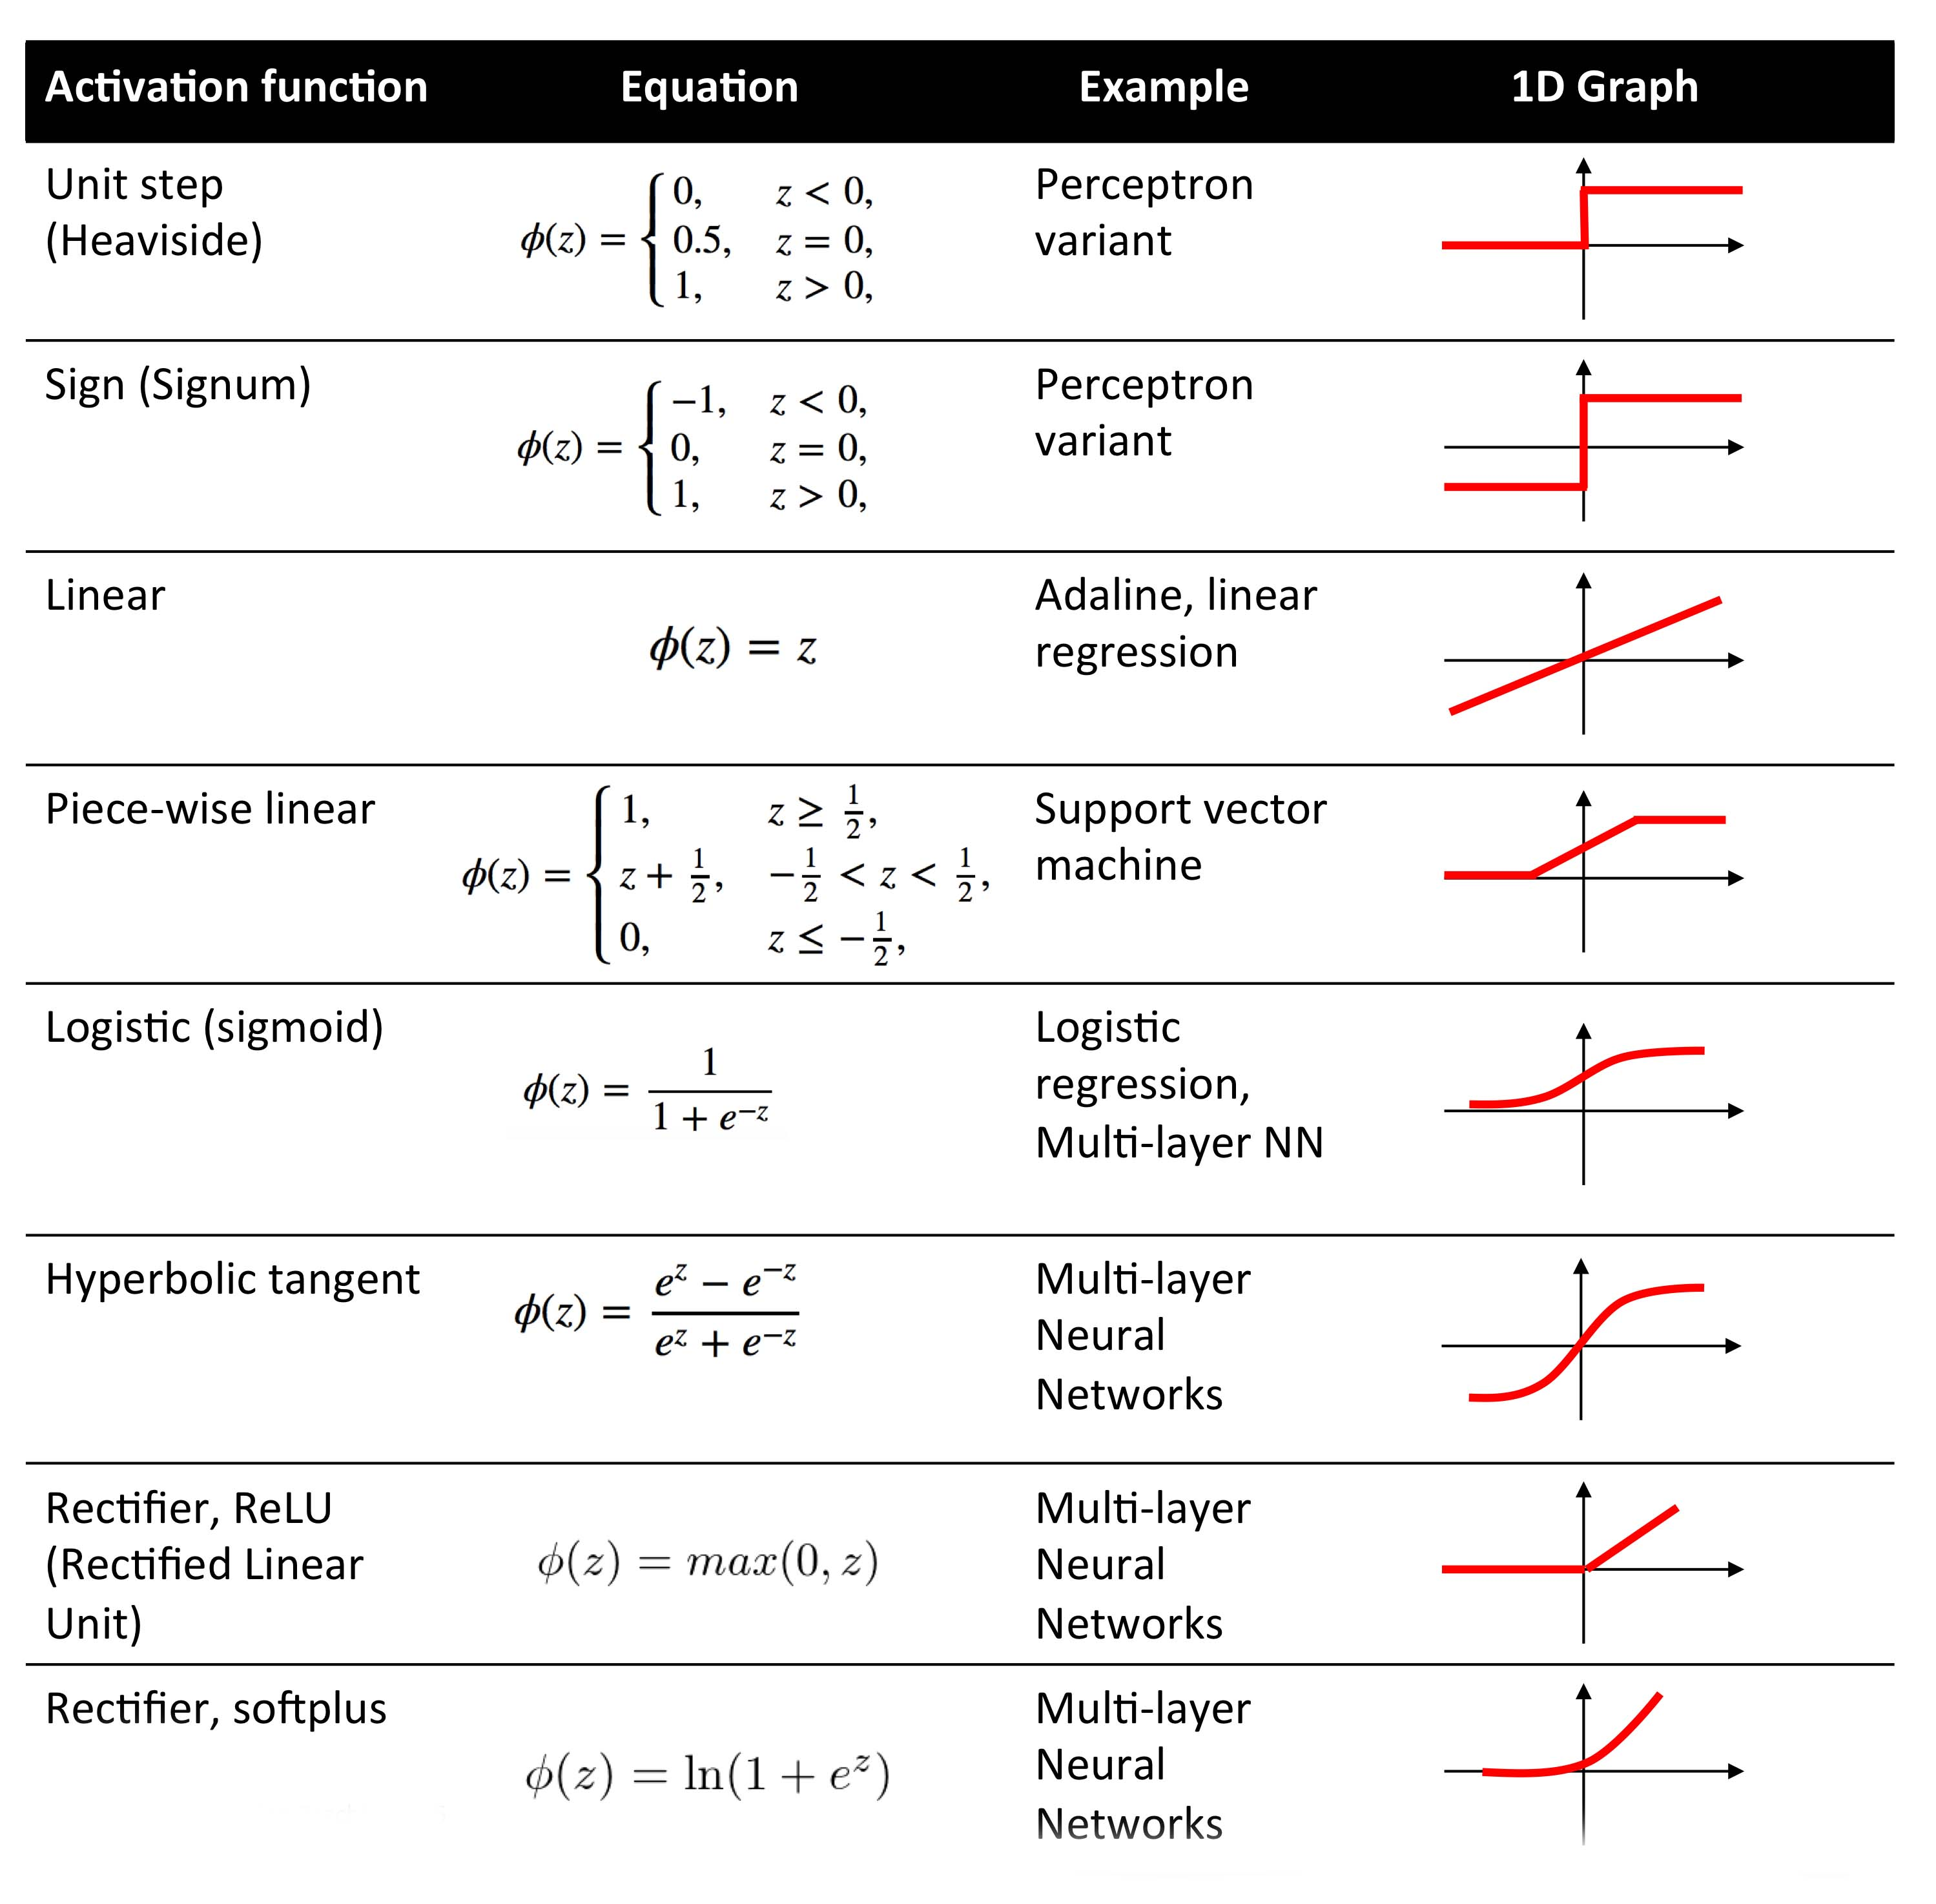
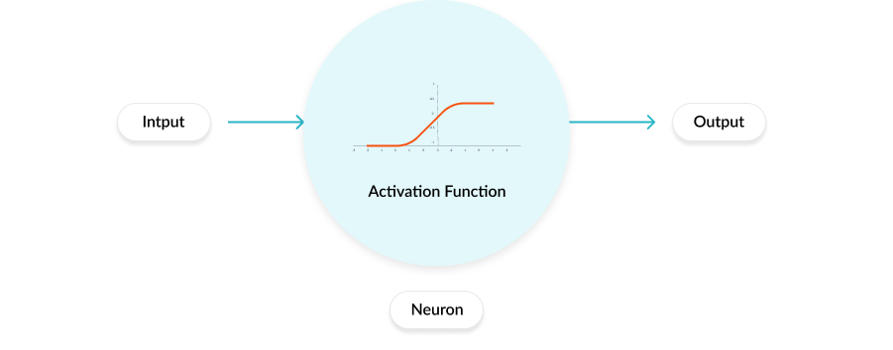
Activation Function:
Activation function decides, whether a neuron should be activated or not by calculating weighted sum and further adding bias with it.
The purpose of the activation function is to introduce non-linearity into the output of a neuron.

Slide 9
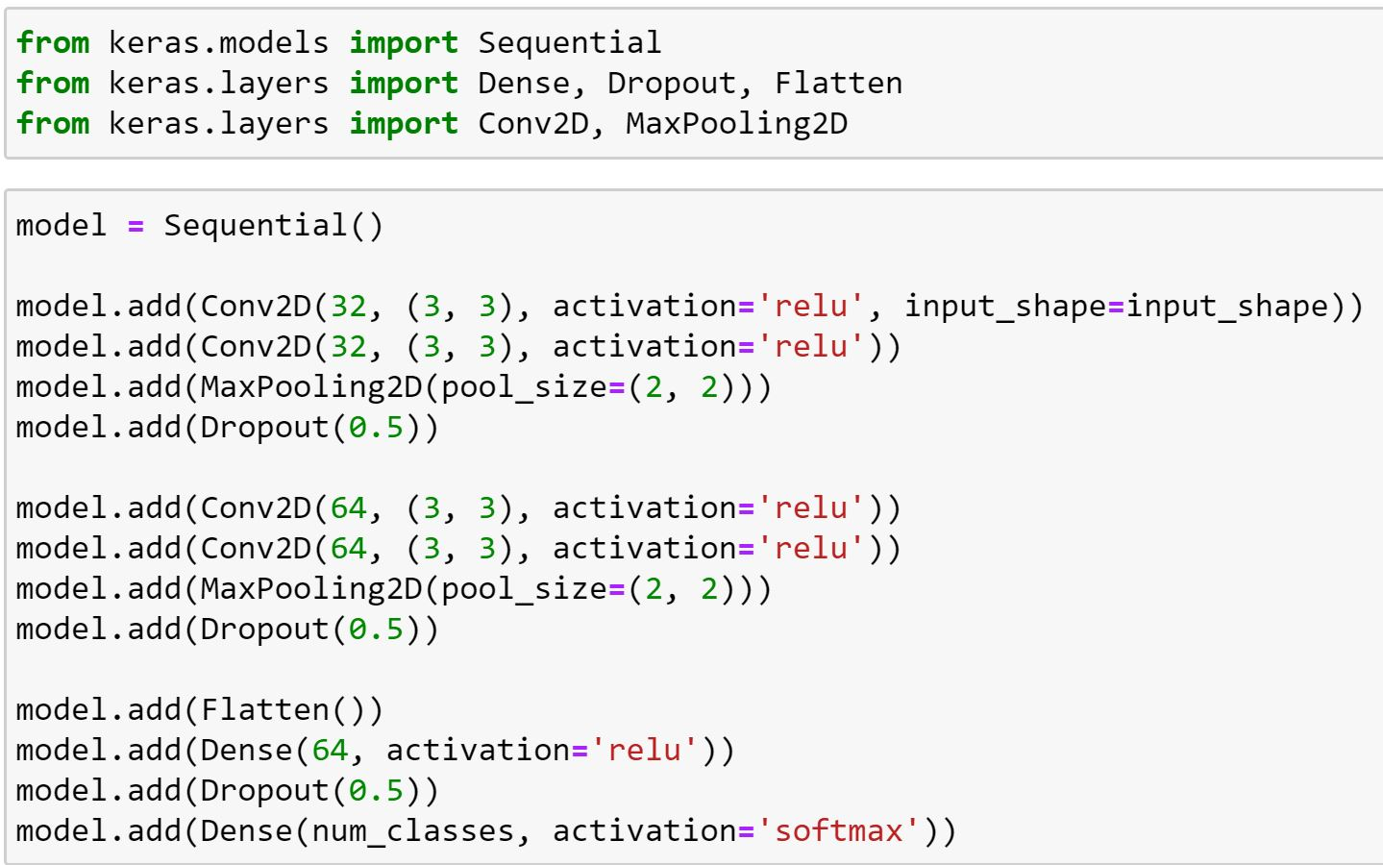
Model Types:
Sequential model allows you to create models layer-by-layer for most problems. It is limited in that it does not allow you to create models that share layers.

Slide 10
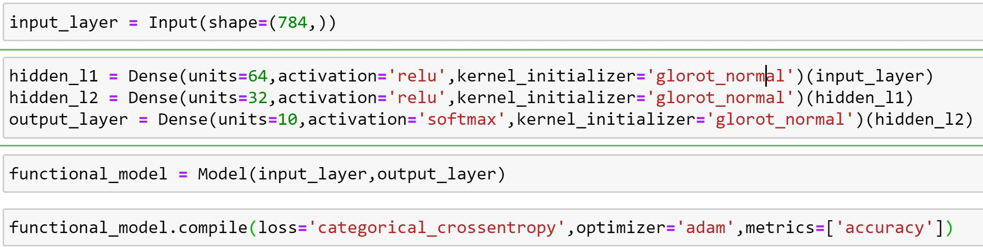
Type - 2:
Functional model allows you to create models that have a lot more flexibility as you can easily define models where layers connect to more than just the previous and next layers. In fact, you can connect layers to (literally) any other layer.
https://medium.com/@hanify/sequential-api-vs-functional-api-model-in-keras-266823d7cd5e

Slide 11

Convolutional Neural Network

Slide 12
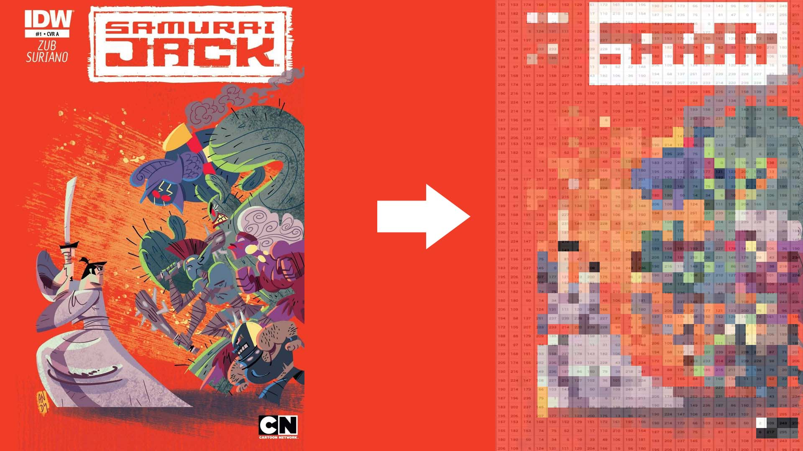
Pixel:
Pixel is the smallest element of an image. Each pixel correspond to any one value. In an 8-bit gray scale image, the value of the pixel between 0 and 255. The value of a pixel at any point correspond to the intensity of the light photons striking at that point. Each pixel store a value proportional to the light intensity at that particular location.

Slide 13
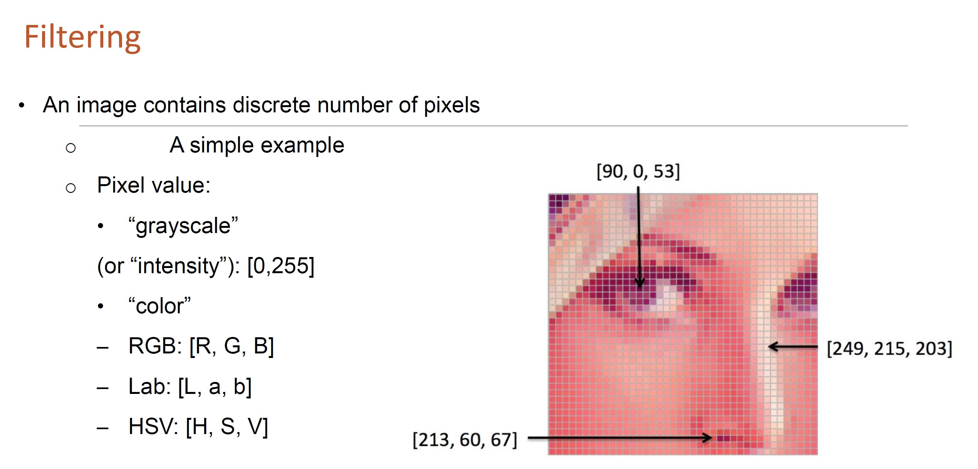

Slide 14
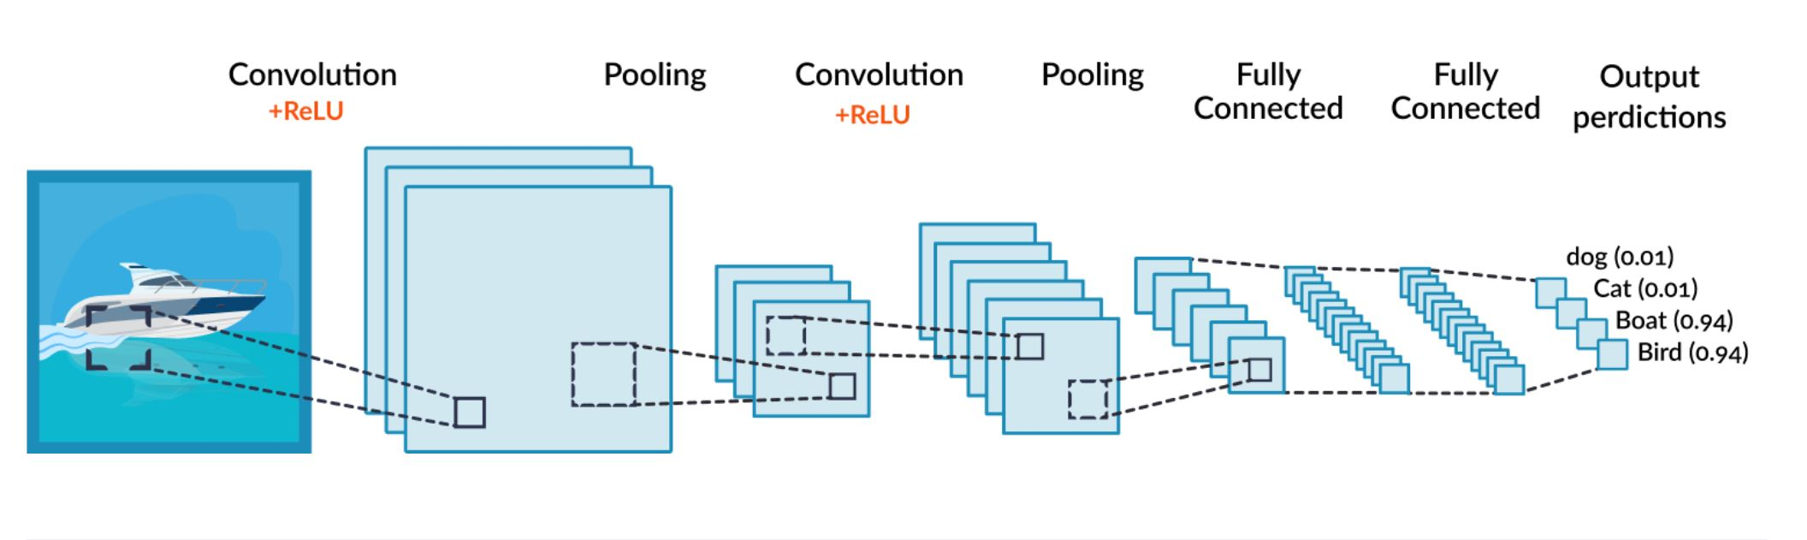
Convolutional Neural Network
A Convolutional Neural Network (CNN) is the foundation of most computer vision technologies. Unlike traditional Neural Network architectures, it uses two operations called ‘convolution’ and ‘pooling’ to reduce an image into its essential features, and uses those features to understand and classify the image.

Slide 15

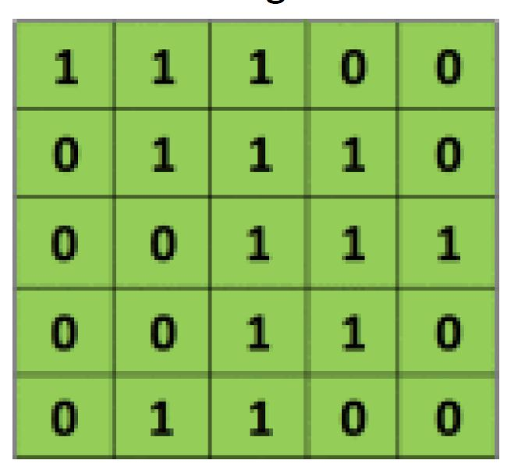
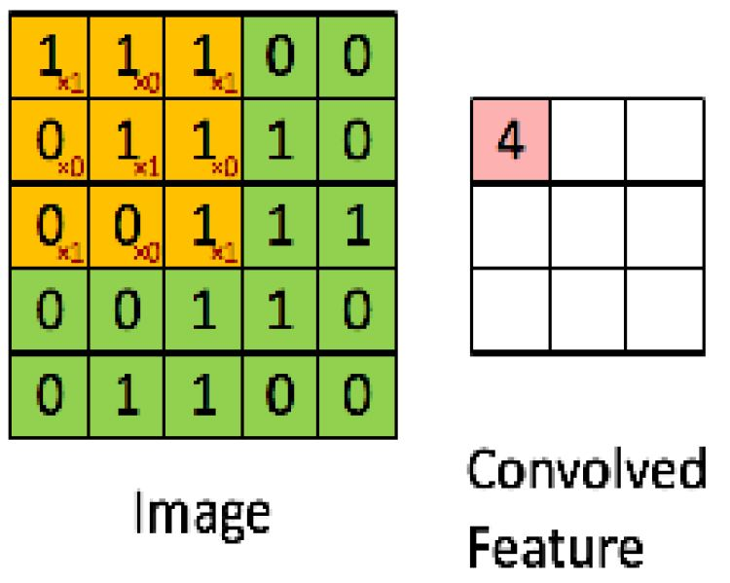
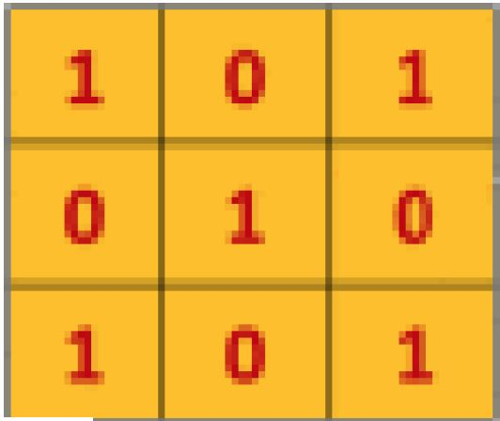
Convolution layer
A “filter”, sometimes called a “kernel”, is passed over the image, viewing a few pixels at a time.
The convolution operation is a dot product of the original pixel values with weights defined in the filter. The results are summed up into one number that represents all the pixels the filter observed.
In general 3x3 or 5x5 size filters will be used. In some cases like Inception Net will use 1x1 sized filter.
Raw Image Kernel Convolution

Slide 16
Kernel initialization
The kernel is initialized via an initialization procedure. There's a variety of methods how, including simple ones like random & Gaussian and there's also more advanced techniques like He initialization, MSRA initialization , Xavier initialization/Glorot initialization.
As for learning, the gradients are calculated using a process called backpropagation which uses the chain rule to calculate gradients. Then, an optimizer such as ADAM or SGD updates each weight based on a function of the calculated gradient
Kernel

Slide 17
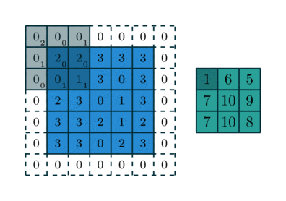
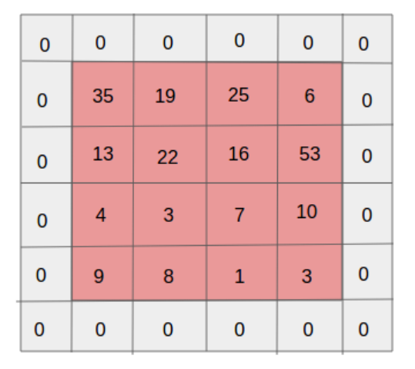
Strides and Padding
The movement of the filter on the input image is called as strides.
Padding refers to the process of symmetrically adding zeros to the input matrix. It’s a commonly used modifications that allows the size of the input to be adjusted to our requirement.
It is mostly used in designing the cnn layers when the dimensions of the input volume need to be preserved in the output volume.

Slide 18

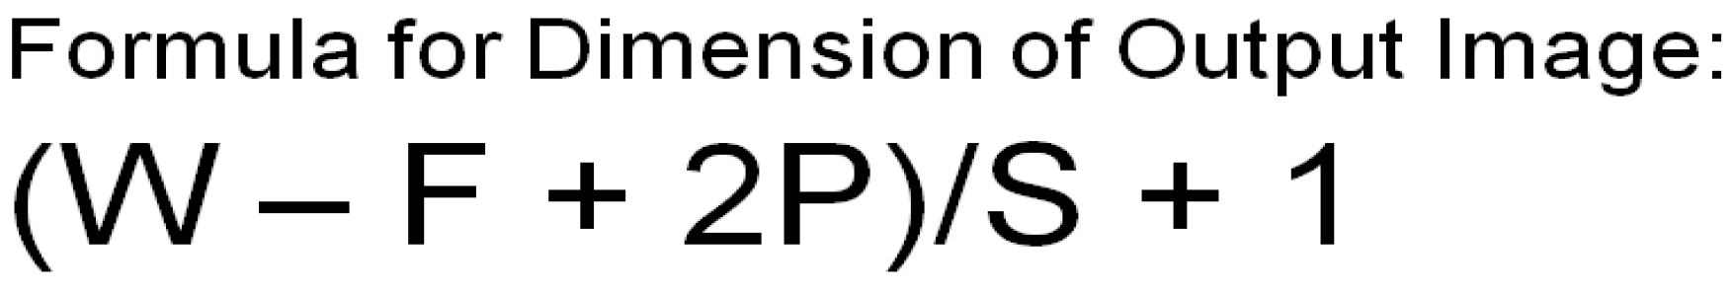

Slide 19
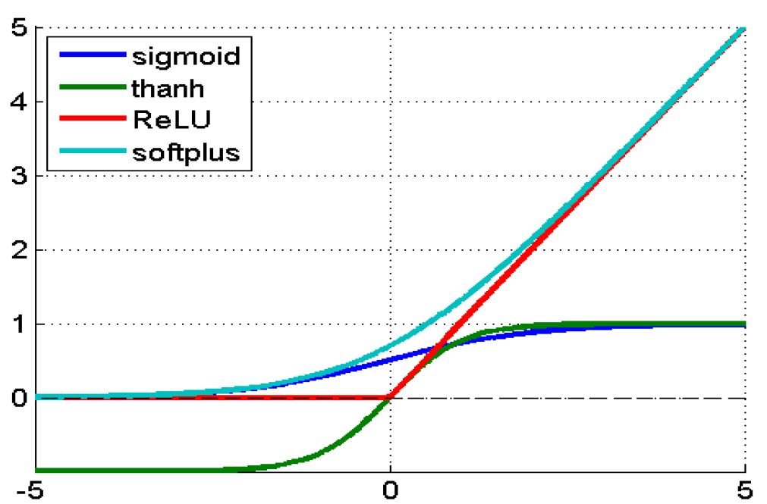
Activation layer
The convolution layer generates a matrix that is much smaller in size than the original image. This matrix is run through an activation layer, which introduces non-linearity to allow the network to train itself via backpropagation. The activation function is typically ReLu.

Slide 20

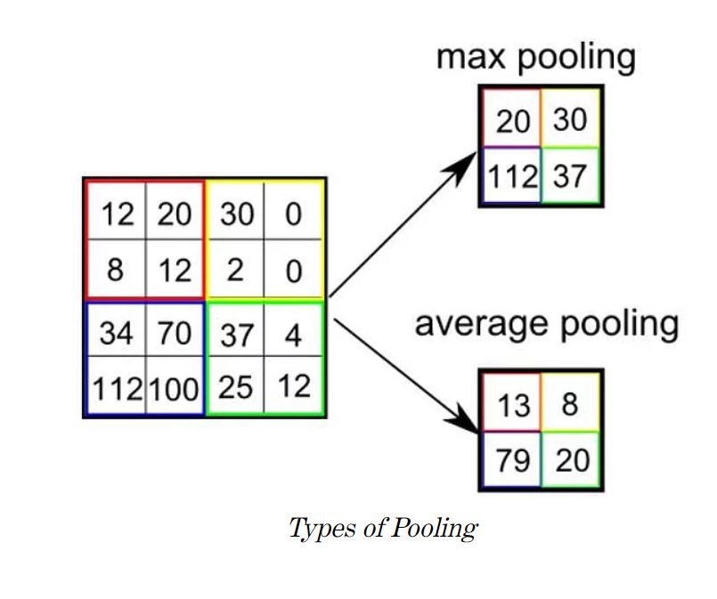
Pooling layer
pooling is the process of further down sampling and reducing the size of the matrix.
A filter is passed over the results of the previous layer and selects one number out of each group of values.
This allows the network to train much faster, focusing on the most important information in each feature of the image.

Slide 21
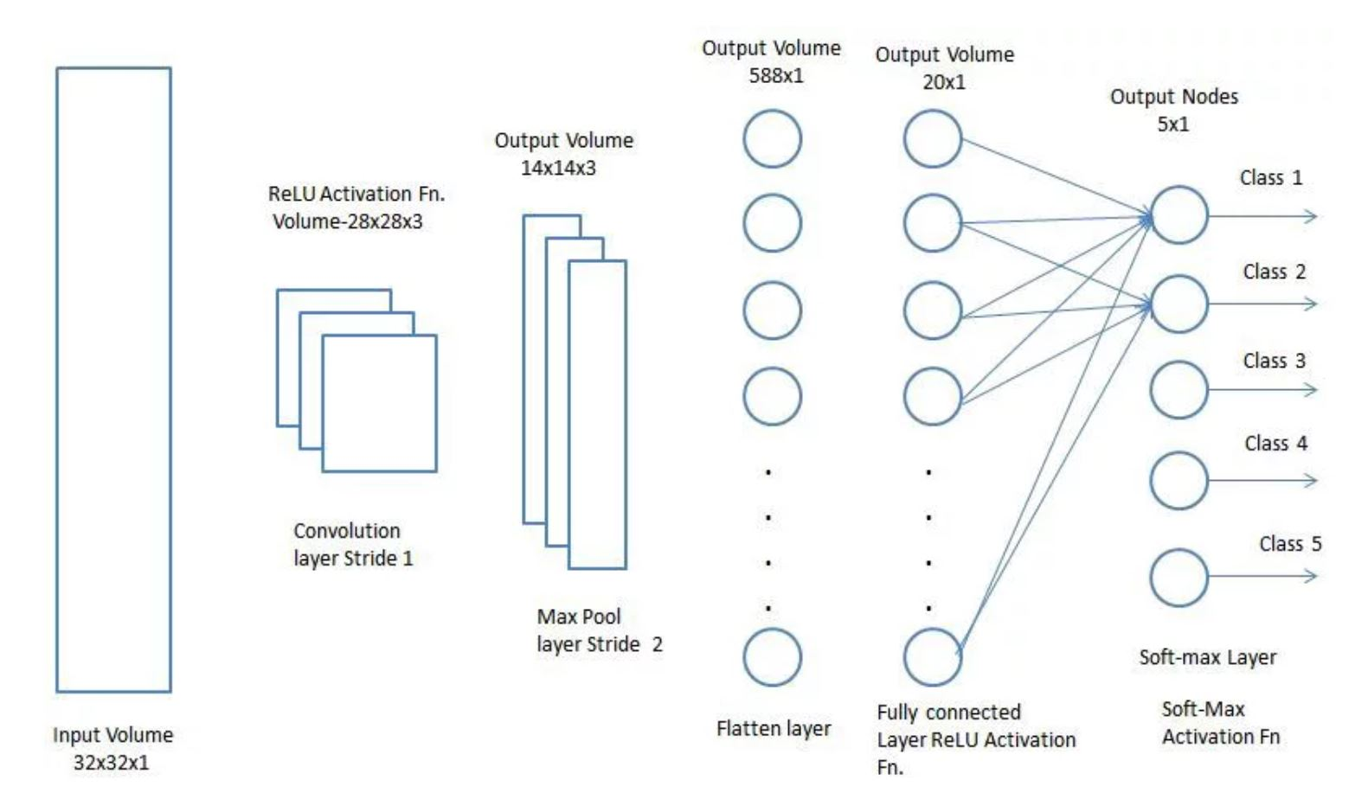
Adding a Fully-Connected layer is a (usually) cheap way of learning non-linear combinations of the high-level features as represented by the output of the convolutional layer.
The Fully-Connected layer is learning a possibly non-linear function in that space.
Now that we have converted our input image into a suitable form for our Multi-Level Perceptron, we shall flatten the image into a column vector. The flattened output is fed to a feed-forward neural network and backpropagation applied to every iteration of training. Over a series of epochs, the model is able to distinguish between dominating and certain low-level features in images and classify them using the Softmax Classification technique.

Slide 22
CNN Overview:
An image input constitutes a 3-dimensional structure called the Input Volume(255x255x3).
CNN’s use filters as kernels where the parameters or weights have to be learnt. A filter is a matrix of lower size than the input to it.
The inputs are convolved with the filters and passed through the activation function.
The weights of the kernels are randomly initialized and are modified during training based on error-minimization using backpropagation.
The real values of the kernel matrix change with each learning iteration over the training set, indicating that the network is learning to identify which regions are of significance for extracting features from the data.
After using convolution use pooling to down sampling.
The final layer should be flattened before providing the input to the fully connected feed forward network.

Slide 23
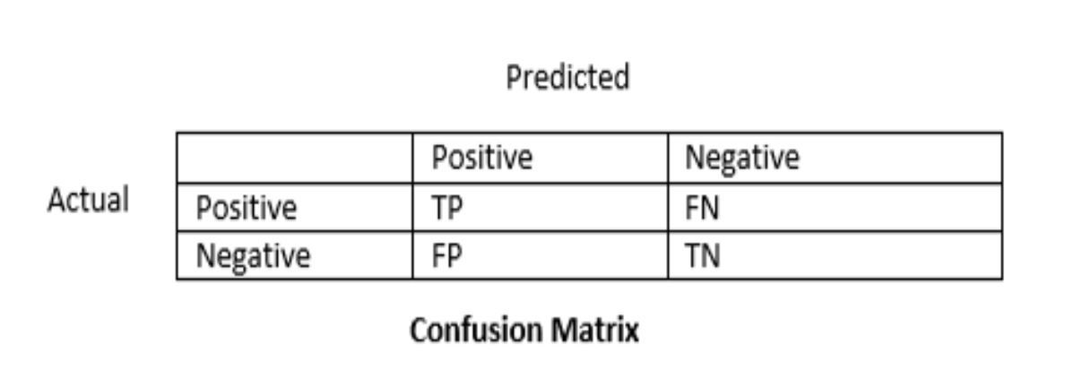
Model :Evaluation
CONFUSION MATRIX
Accuracy.
Recall or Sensitivity.
Specificity.
Precision.
model.compile(loss='binary_crossentropy', optimizer='adam', metrics=['accuracy'])
# Fit the model
model.fit(X_train, y_train, validation_data=(X_test,y_test), epochs=150, batch_size=10)

Slide 24
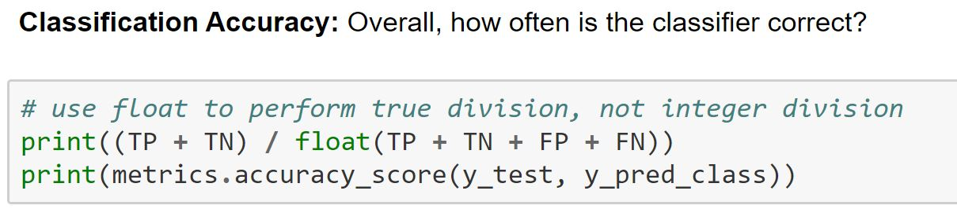
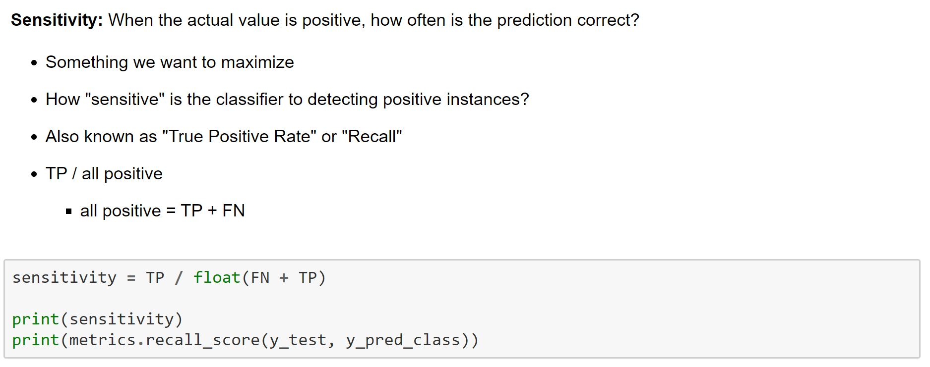
Accuracy
Sensitivity

Slide 25
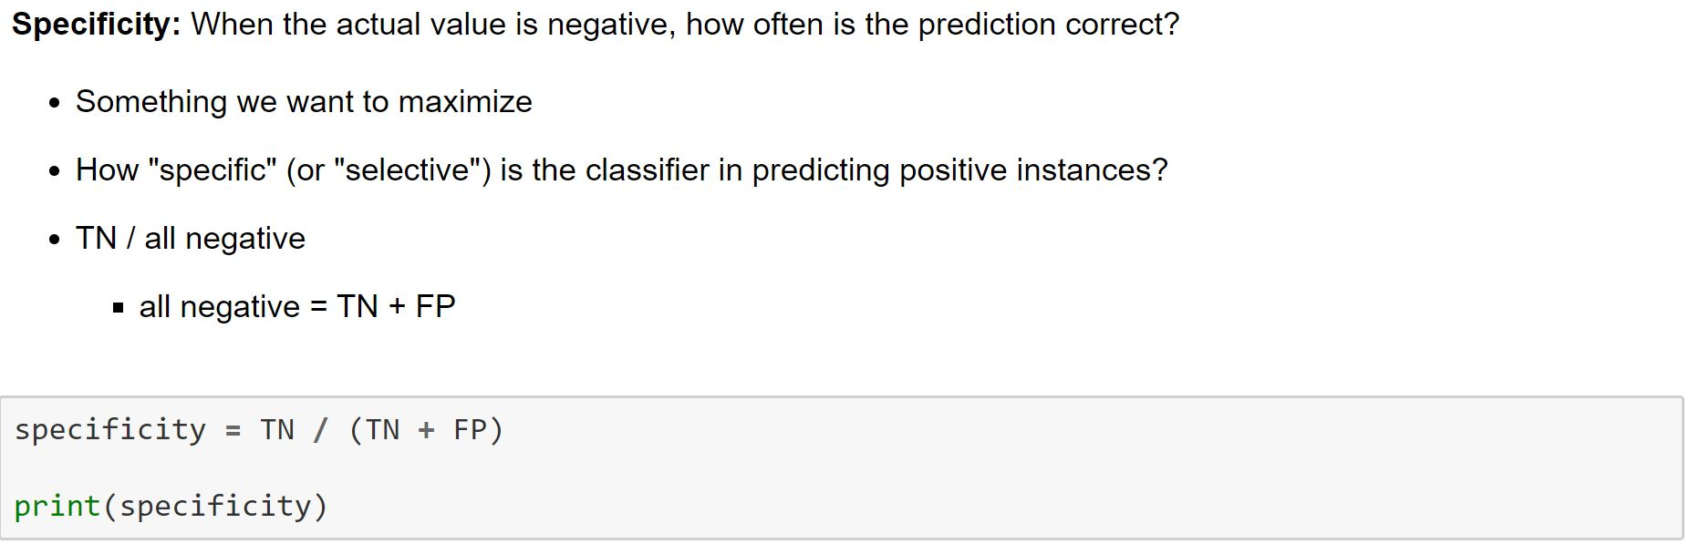
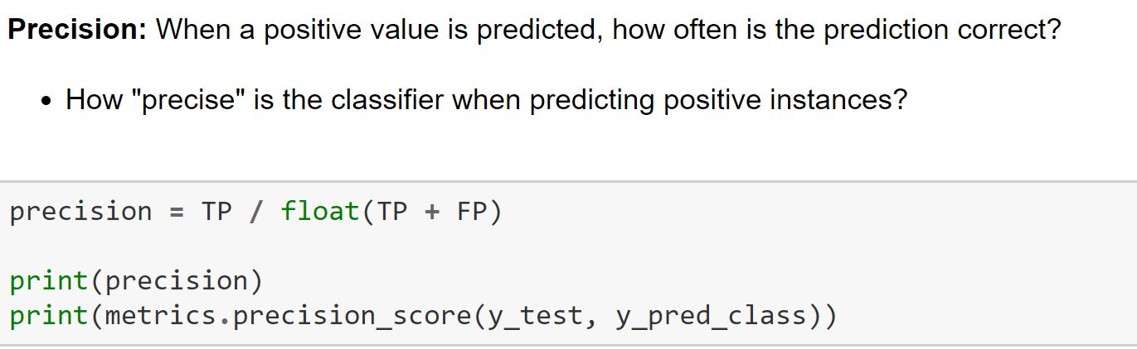
SPECIFICITY
PRECISION

Slide 26
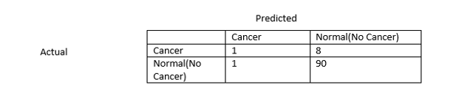
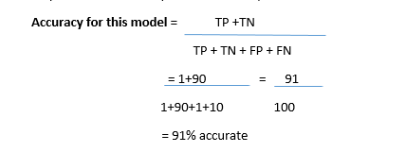
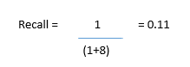
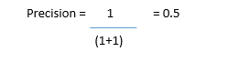
Problem Statement:
Build a prediction model for hospitals to identify whether the patient is suffering from cancer or not .
Let’s assume we have a training dataset with labels—100 cases, 10 labelled as ‘Cancer’, 90 labelled as ‘Normal’

Slide 27
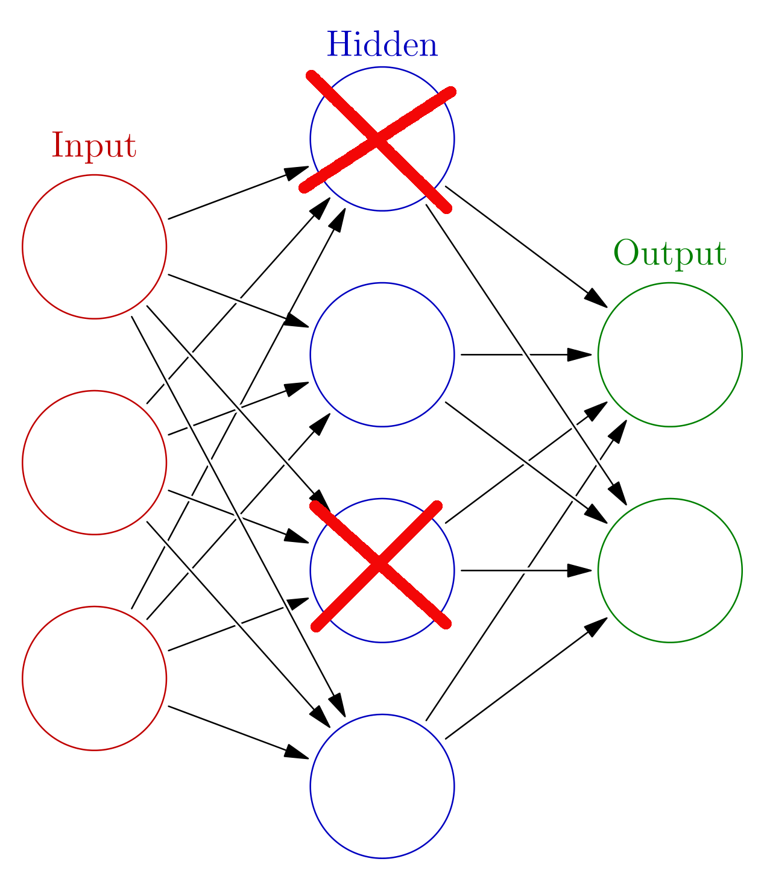

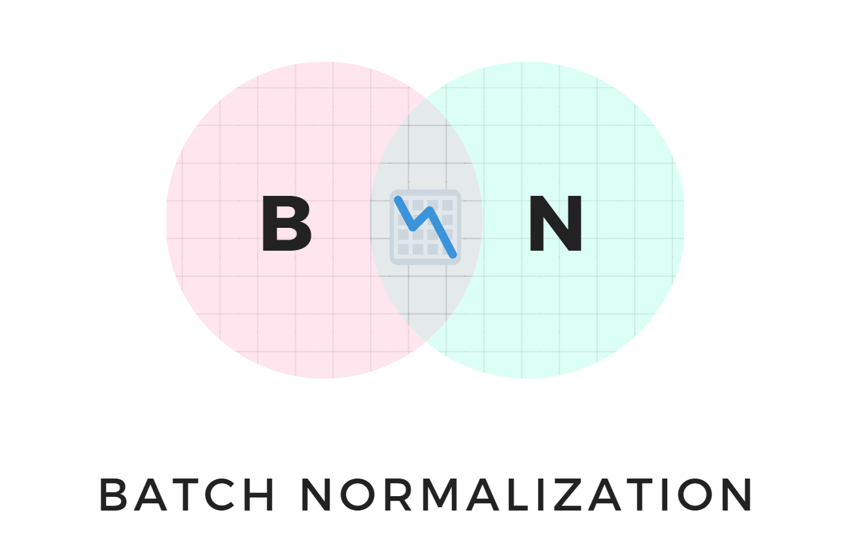
optimization techniques
Regularization techniques
Drop out

Slide 29
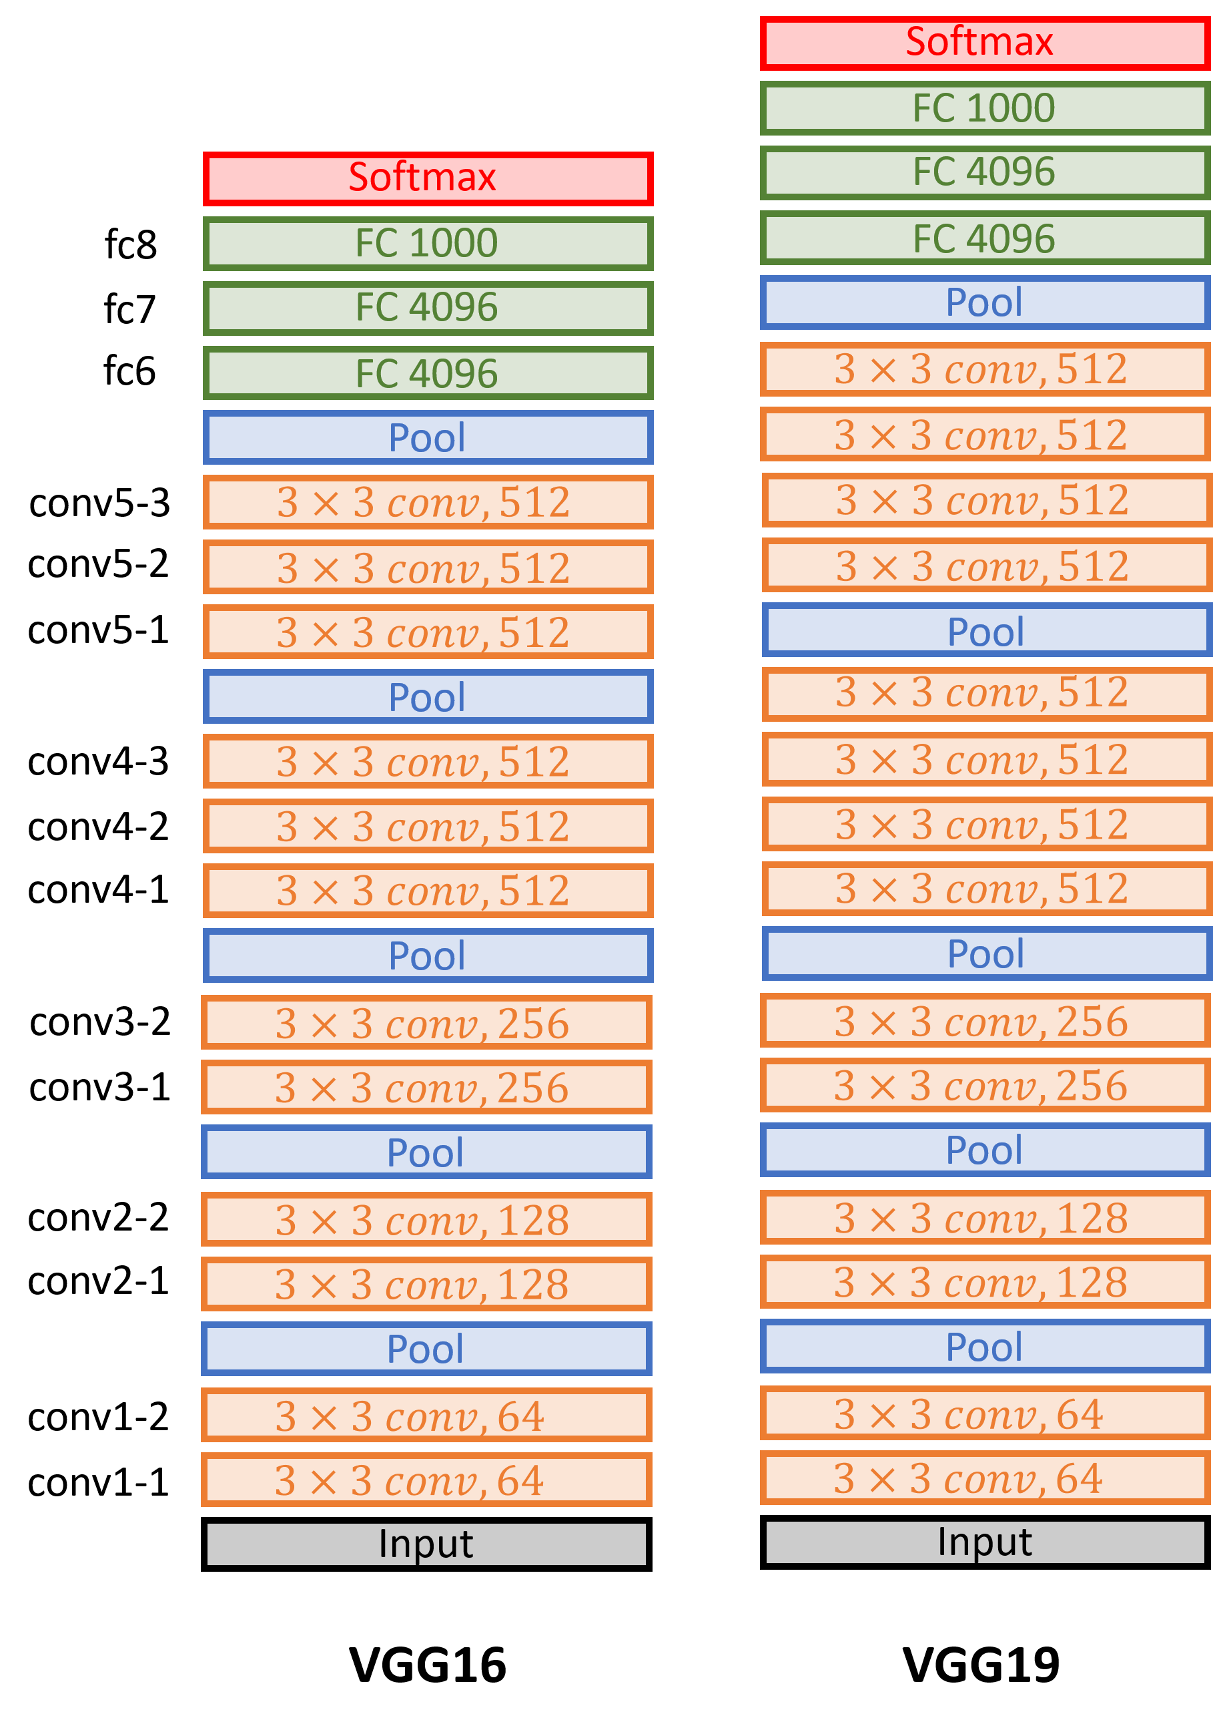
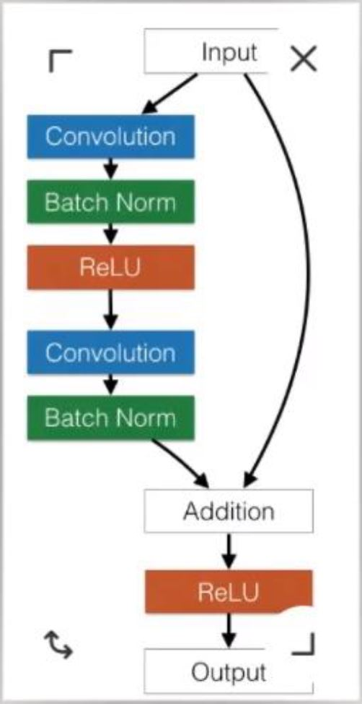
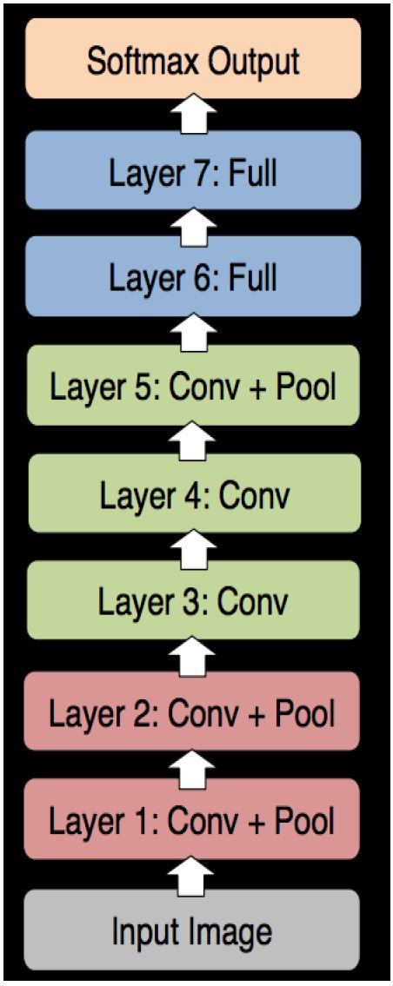
Pre-Trained CNN Models
Alex net VGG Resnet (150-1000)
Error :18.2% Error: 7.3% Error:3.57%

Slide 30
YOLO V3
YOLO stands for “You Only Look Once” and uses convolutional neural networks (CNN Darknet) for object detection.
When YOLO works, it predicts classes labels and detects locations of objects at the same time. That is why, YOLO can detect multiple objects in one image.
The name of the algorithm means that a single network just once is applied to whole image. YOLO divides image into regions, predicts bounding boxes and probabilities for every such region.
YOLO-3 uses successive 3x3 and 1x1 convolutional layers.
In total it has 53 convolutional layers. Every layer is followed by Batch normalization and Leaky ReLU activation.
.

Slide 31
Architecture of Darknet-53

Slide 32
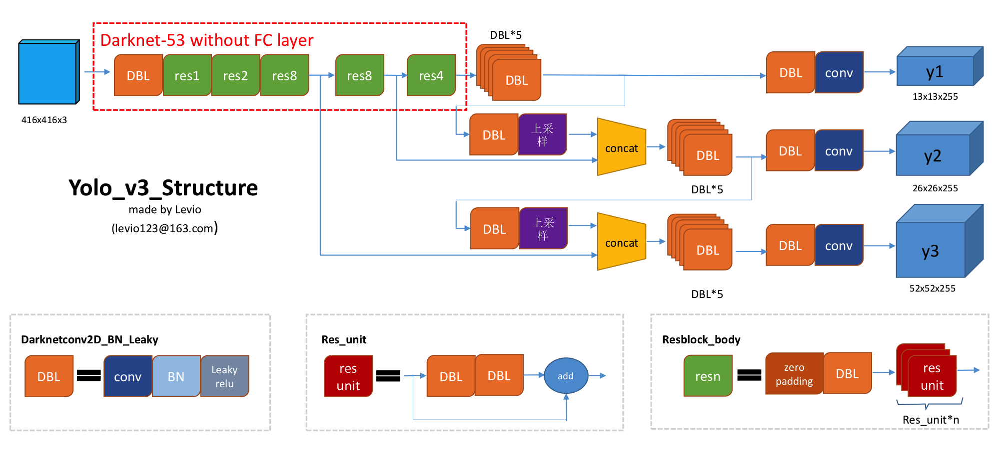
Yolo V3 Structure

Slide 33
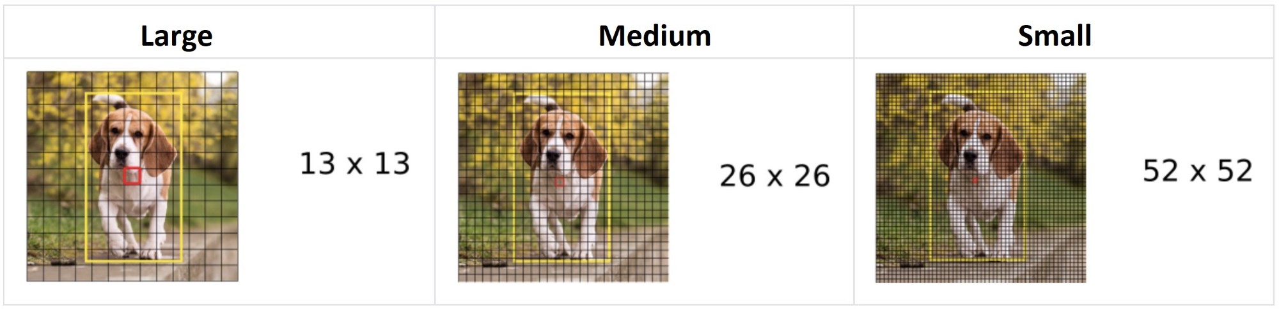
Multi-scale detection
YOLO performs coarse, medium, and fine meshing of the input image to enable the prediction of large, medium, and small objects, respectively.
If the size of the input picture is 416X416, then the coarse, medium, and fine grid sizes are 13x13, 26x26, and 52x52 respectively. In this way, it is scaled by 32, 16 and 8 times in length and width respectively.

Slide 34
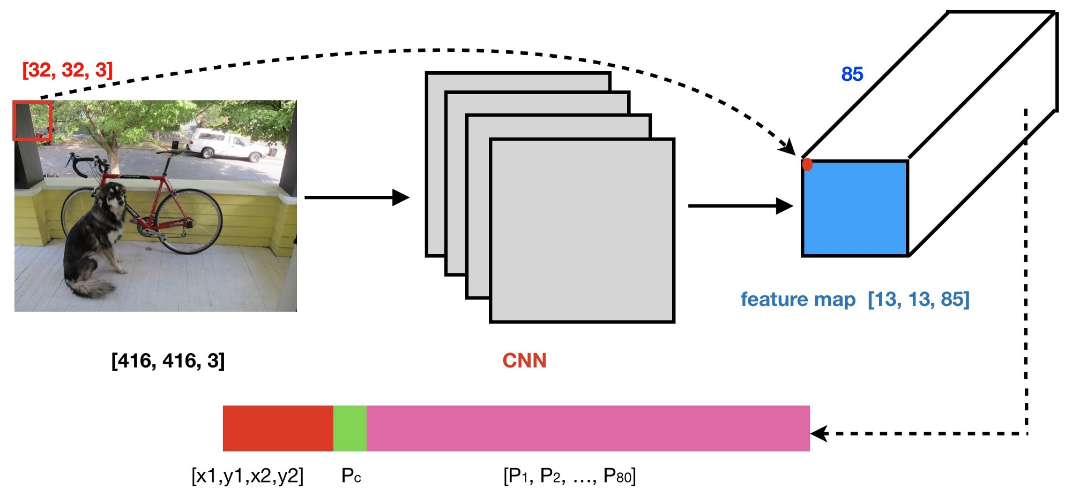
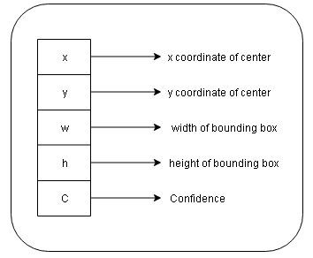
Yolo V3 Workflow
Step 1: The Input image is split into SxS Grids.
Step 2: The input image goes through a CNN, resulting in a (SxS,5,85) dimensional output.
YOLO also predicts confidence(C) for every bounding box showing information that this particular bounding box actually includes object, and probability of included object in bounding box being a particular class.
85 = 5 + 80(P1-P80) where 5 is because (𝑝𝑐,𝑏𝑥,𝑏𝑦,𝑏ℎ,𝑏𝑤) has 5 numbers, and 80 is the number of classes we’d like to detect (These classes are from pretrained coco data set.)

Slide 35
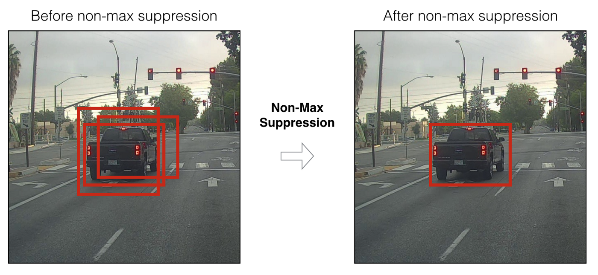
Step 3: We then select only few boxes based on: 1. Score-thresholding: throw away boxes that have detected a class with a score less than the threshold. 2. Non-max suppression: Compute the Intersection over Union and avoid selecting overlapping boxes.
Step 4: This gives us YOLO’s final output.

Slide 36

Application Types
Image classification: aims at assigning an image to one of a number of different categories (e.g. car, dog, cat, human, etc.). essentially answering the question “What is in this picture?”. One image has only one category assigned to it.
Object localization: Allows us to locate our object in the image, so our question changes to “What is it and where it is?”.
Object detection: provides the tools for doing just that – finding all the objects in an image and drawing the so-called bounding boxes around them. There are also some situations where we want to find exact boundaries of our objects in the process called instance segmentation.

Slide 37
Some Industrial Applications:
Autonomous car driving is becoming more and more popular. Car driving system processes images in and around the car in real time. By processing these images it can understand hurdles in its navigation track and avoid accidents.
License Plate recognition: Here techniques like OCR (optical character detection) is used to recognize characters in license plat and convert it to a text. This is useful on toll booth or unmanned speed deterrents on freeway.
Face Detection and Recognition: In computer vision application identifying a face and drawing rectangle around it is crucial to understand if image contains image and if it does, who is that person. Once you understand fundamentals of drawing and image manipulation, you have a head start.
Medical/Biological image processing for HRA (e.g., interpretation of X-ray images, blood/cellular microscope images, cancer prediction).
Manufacturing Industries, machine is used for detection, counting, and measuring in order to help automate the process.

Slide 38


